Slide 1


HOSPITAL EMERGENCY ROOM DASHBOARD
Prepared By: VAMSI ALLURI
Date: SEP,2025

Slide 2
HOSPITAL EMERGENCY ROOM DASHBOARD
STEPS IN PROJECT
Requirement Gathering/ Business Requirements
Data Walkthrough
Data Connection
Data Cleaning / Quality Check
Data Modeling
Data Processing
DAX Calculations
Dashboard Lay outing
Charts Development and Formatting
Dashboard / Report Development
Insights Generation

Slide 3
HOSPITAL EMERGENCY ROOM DASHBOARD
KEY METRICS (KPIs)
Total No. of Patients
Avg. Wait Time
Patient Satisfaction Score
No. of Patients Referred

Slide 4
HOSPITAL EMERGENCY ROOM DASHBOARD
DASHBOARD NAVIGATION
Monthly View
Consolidated View
Patient Details
Key Take Aways

Slide 5
HOSPITAL EMERGENCY ROOM DASHBOARD
BUSINESS REQUIREMENTS
Dashboard 1: Monthly View
Objective: Monitor key metrics and trends on a month-by-month basis to identify patterns and areas for improvement.
Charts to Develop:
Patient Admission Status: Track admitted vs. non-admitted patients.
Patient Age Distribution: Group patients by 10-year age intervals.
Department Referrals: Analyze referral trends across different departments.
Timeliness: Measure the percentage of patients seen within 30 minutes.
Gender Analysis: Visualize patient distribution by gender.
Racial Demographics: Analyze patient data by race.
Time Analysis: Assess patient volume by day and hour.

Slide 6
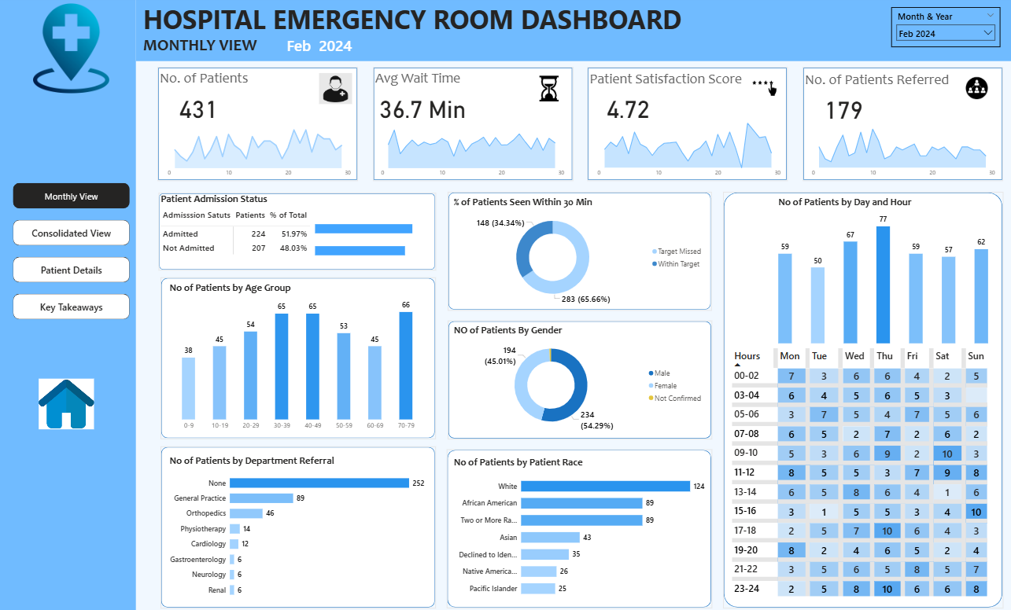
HOSPITAL EMERGENCY ROOM DASHBOARD Dashboard 1: Monthly View

Slide 7
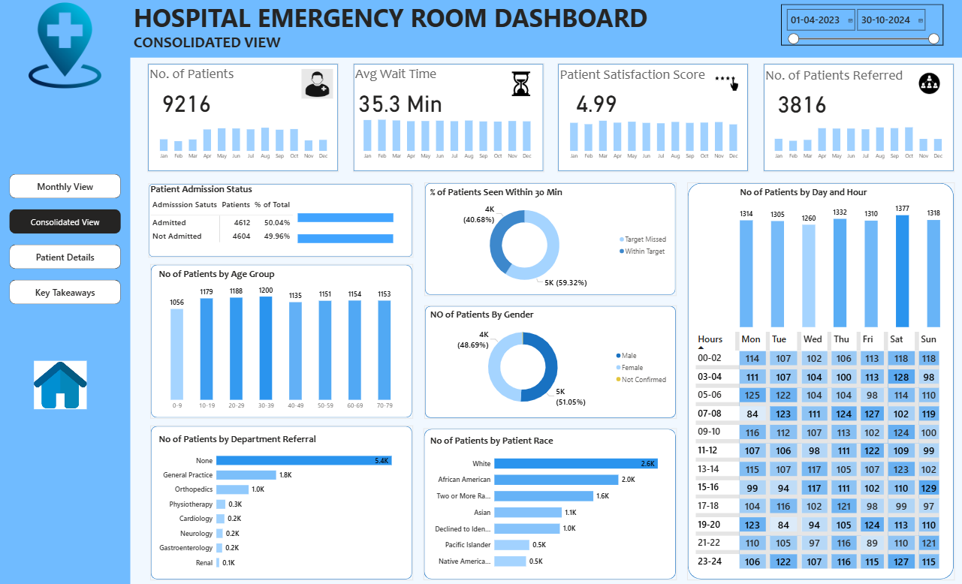
HOSPITAL EMERGENCY ROOM DASHBOARD
Dashboard 2: Consolidated View
Objective: Provide a holistic summary of hospital performance for a selected date range.
Charts to Develop:
Similar metrics as the Monthly View, but aggregated over a customizable date range for broader insights and trend analysis

Slide 8
HOSPITAL EMERGENCY ROOM DASHBOARD
BUSINESS REQUIREMENTS
Dashboard 3: Patient Details
Objective: Offer granular insights into patient-level data to enable detailed analysis and troubleshooting.
Charts to Develop: A grid displaying essential fields:
Patient ID
Patient Full Name
Gender
Age
Admission Date
Patient Race
Wait Time
Department Referral
Admission Status

Slide 9
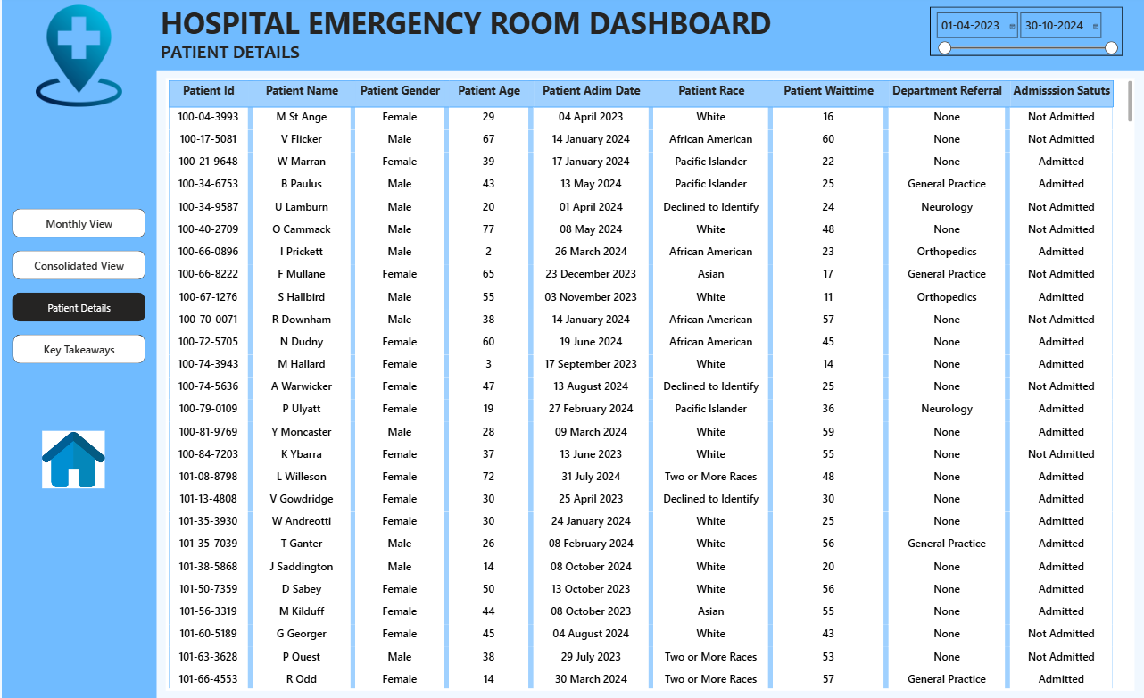
HOSPITAL EMERGENCY ROOM DASHBOARD
Dashboard 3: Patient Details

Slide 10
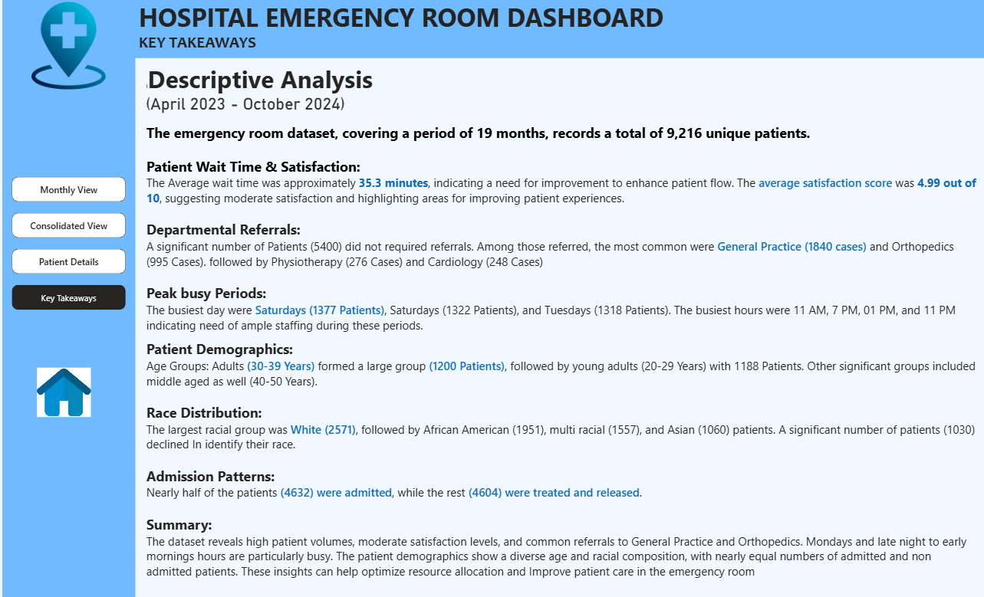
HOSPITAL EMERGENCY ROOM DASHBOARD
BUSINESS REQUIREMENTS
Dashboard 4: Consolidated View
Objective: Summarize the findings from all dashboards to provide clear and actionable insights for stakeholders.
Charts to Develop: Descriptive analysis of each metric and visualization, including patterns, anomalies, and actionable recommendations to optimize emergency
room operations and patient care.

Slide 11
HOSPITAL EMERGENCY ROOM DASHBOARD
SUMMARY
The project analyzes ER data spanning 19 months, covering 9,216 patient records.
Objective: Deliver actionable insights to optimize patient flow, wait times, satisfaction, and resource allocation.
Tools: Power BI, Excel, DAX, Data Cleaning, Dashboard Design.

Slide 12
THANK YOU
Prepared by: VAMSI ALLURI
Contact info: vamsialluri2004@gmail.com

